Slide 1

Introduction to Machine Learning
Data Visualization
By <Trainer’s Name>
<Date>

Slide 2
Basics of Data Visualization
<Topic>

Slide 3

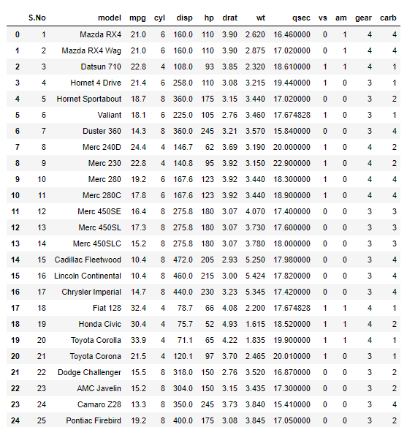
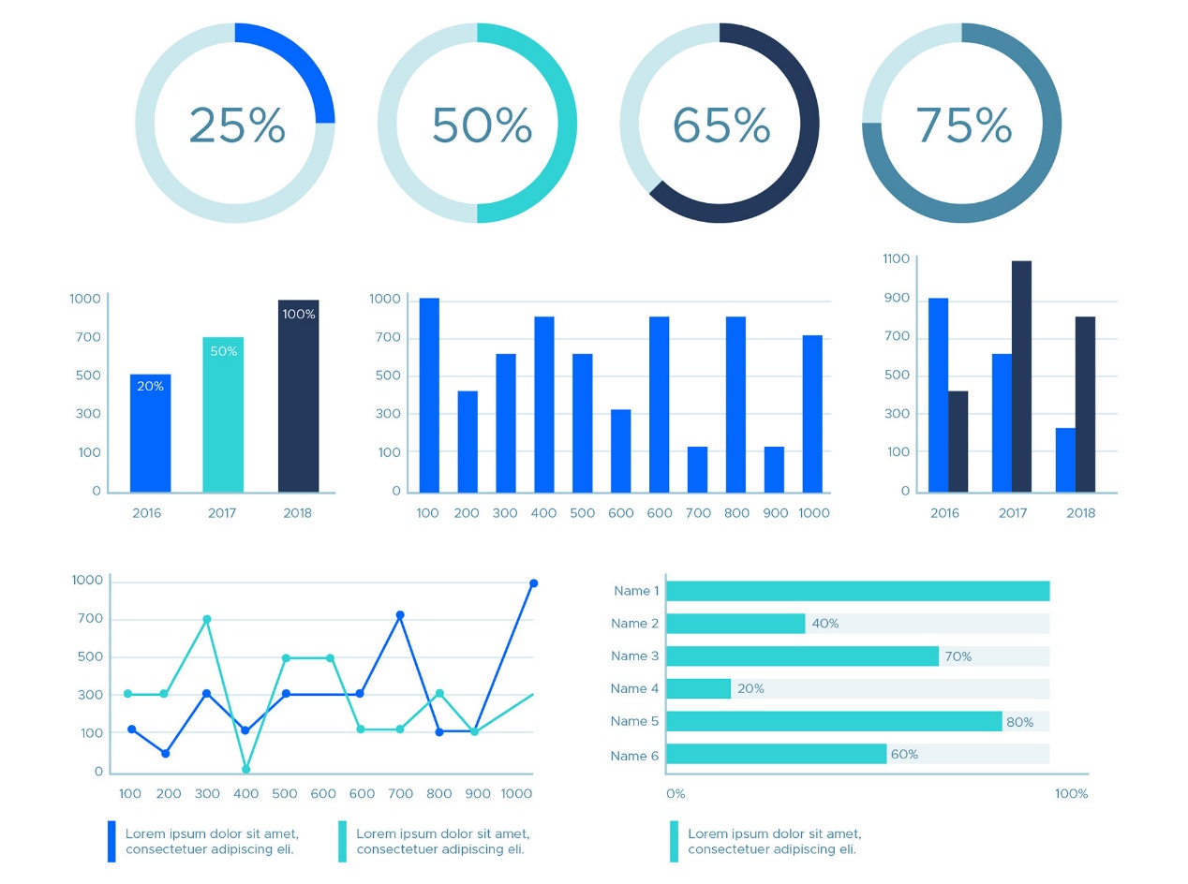
Basics of Data Visualization
Data visualization is the graphical/pictorial representation of information and data

Slide 4
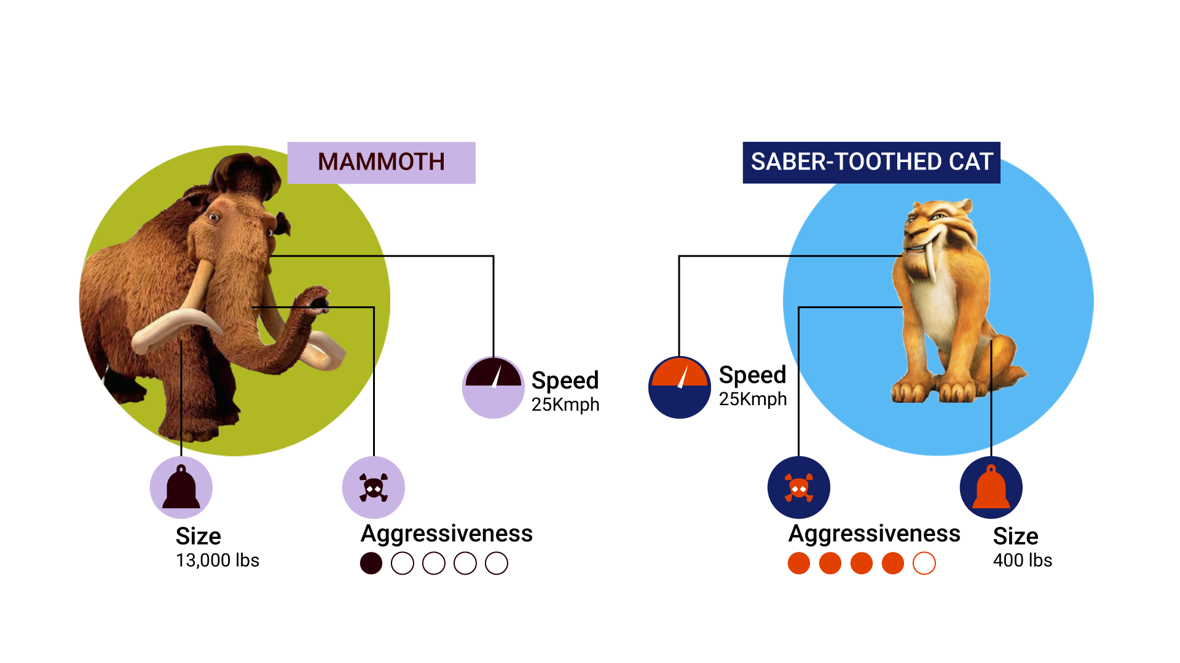
Basics of Data Visualization
A simple data visualization example
Name of Animal | Speed | Aggressiveness | Size
Mammoth | 25 | low | 13000lbs
Saber-Tooth Cat | 75 | High | 400lbs
Mammoth
Saber-Tooth Cat
25kmph
75kmph

Slide 5

Basics of Data Visualization
Why should you visualize data?
To understand more about this, let us talk about an English statistician Francis Anscombe. He developed Anscombe’s quartet and showed the importance of visualizing data.

Slide 6
Basics of Data Visualization
But how exactly did he show that?
To put it simply, his quartet contains 4 datasets with 11 (x,y) pairs. When you look at the descriptive statistics of these datasets, they are very similar. But when you graph them, their distribution is COMPLETELY different.
Seems interesting? Let us dig more into this.

Slide 7
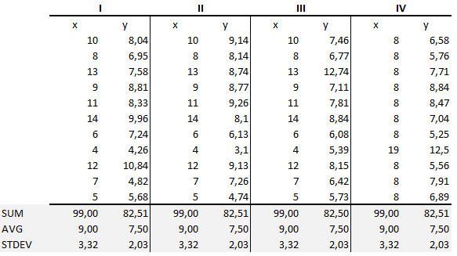
Basics of Data Visualization
Anscombe’s Dataset

Slide 8
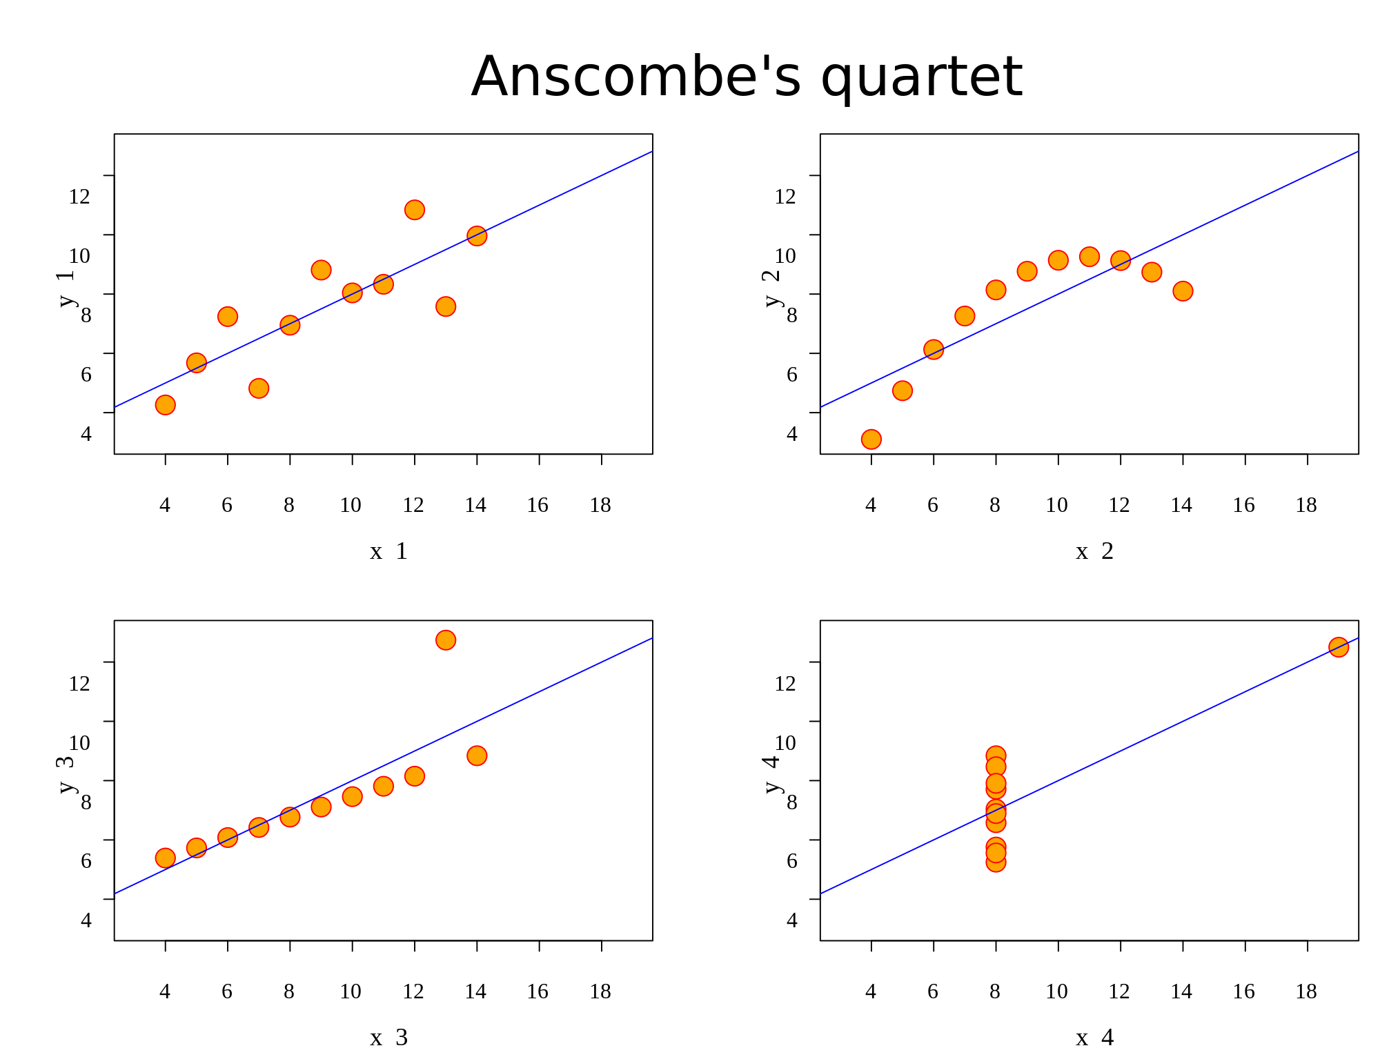
Basics of Data Visualization
Anscombe’s Dataset when graphed

Slide 9



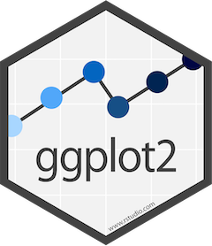
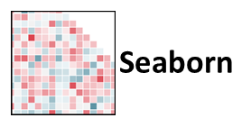
Basics of Data Visualization
These are the popular Python libraries for data visualization
Altair

Slide 10
Matplotlib
<Topic>

Slide 11
Matplotlib
Matplotlib is the most popular Python library for data visualization. Used to create 2D plots and graphs using Python scripts which is publication quality.

Slide 12
Matplotlib Concepts
There are few components and functions you will have to understand before starting off with Matplotlib. We will look at the important matplotlib functions.
Functions | Description
.plot() | This function is used to plot the array data onto a graph
.show() | Shows the plotted graph as the output
.grid() | Set the visibility of grids as True or False
.set_title() | Give a title label to your graph

Slide 13
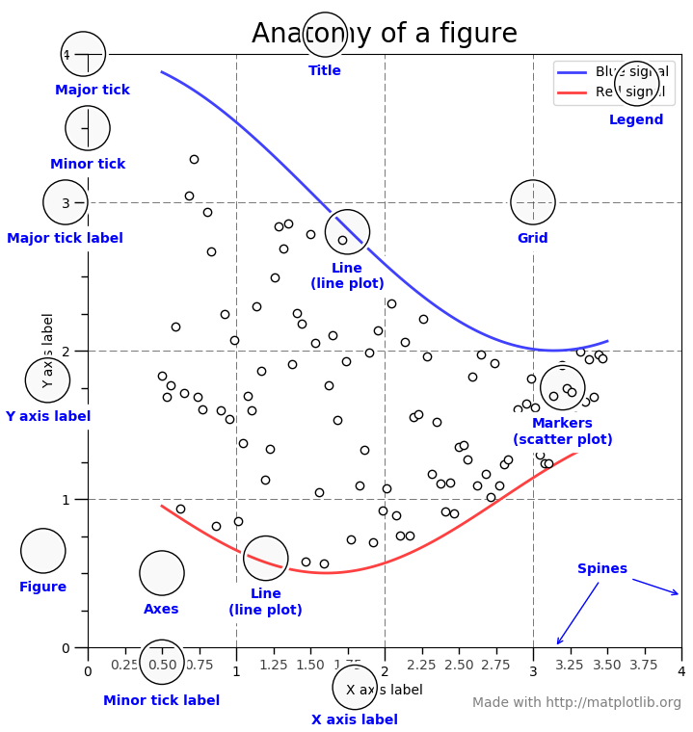
Matplotlib Concepts
Anatomy of a Matplotlib figure
Axes class – Axes is the data space and can be identified in the figure. A figure can contain many Axes, but a particular Axes object can be in only one figure
An Axes object has 2 Axis objects, an x-label (set_xlabel()) and a y-label (set_ylabel())

Slide 14
Matplotlib Concepts
In the plot() function, you can mention the colour, marker and style of the line
Colour Codes
Marker Codes
Character | Colour
b | Blue
g | Green
r | Red
c | Cyan
m | Magenta
y | Yellow
w | White
k | Black
Character | Description
. | Point marker
o | Circle marker
x | X marker
D | Diamond marker
H | Hexagon marker
s | Square marker
+ | Plus marker

Slide 15
Matplotlib Concepts
Line Styles
Character | Description
- | Solid line
--- | Dotted line
-. | Dash-dot line
: | Dotted line
H | Hexagon marker

Slide 16
Types of plots
<Topic>

Slide 17
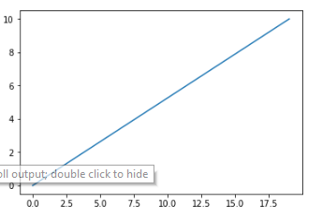
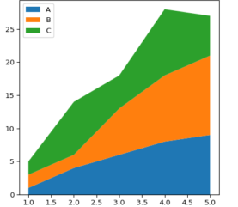
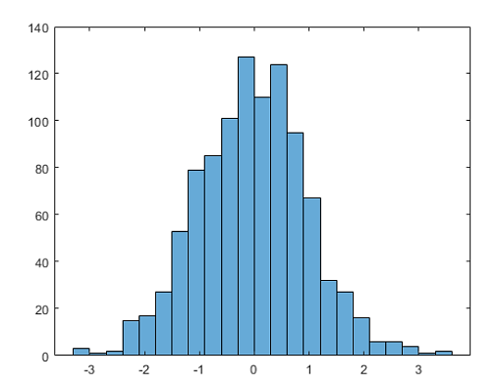
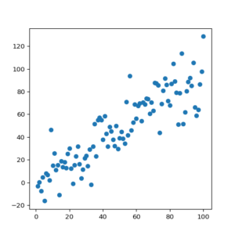
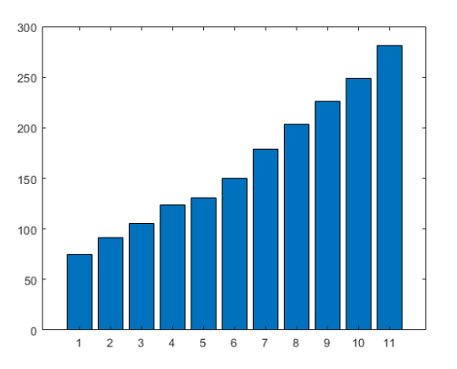
Types of Plots
Line Plot
Area Plot
Histogram
Scatter Plot
Bar Plot

Slide 18
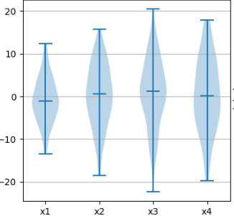
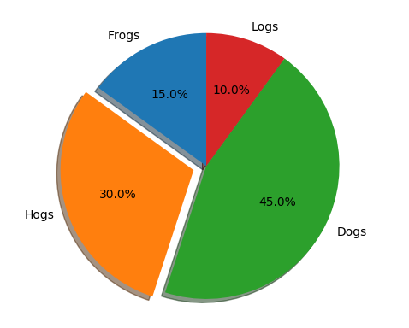
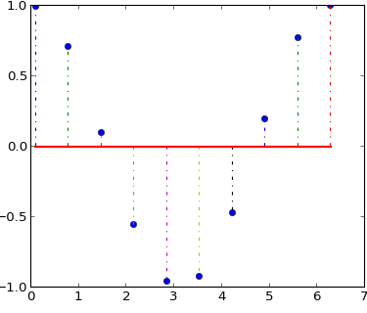
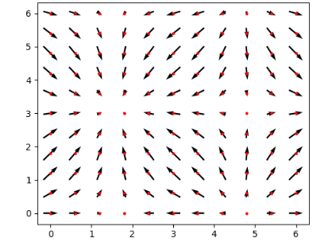
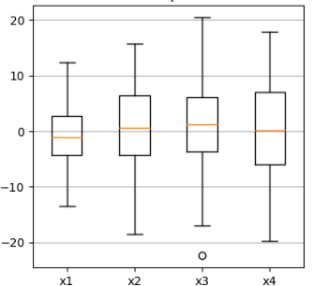
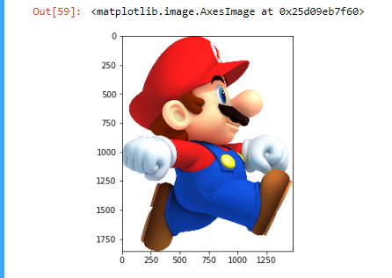
Types of Plots
Violin Plot
Pie Plot
Stream Plot
Quiver Plot
Box Plot
Image Plot

Slide 19
Types of Plots
Few takes on when to choose a type of graph or plot
Comparing values
Distribution of data
Comparing continuous data
Bar plot
Line plot
Pie chart
Scatter plot
Box plot
Violin plot
Histogram
Box plot
Area plot

Slide 20
Line and Area Plot
Line plot
It is best to use a line plot when comparing fewer than 25 numbers. It is a quick, simple way to organize data.
Area plot
Used to represent cumulative totals using numbers or percentages over time.

Slide 21
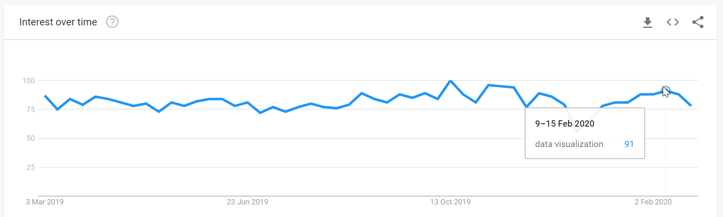
Line and Area Plot
When should you choose a Line plot?
Line plots can be used when we are trying to compare trends over a period of time. For example, searching a word on google over time.

Slide 22
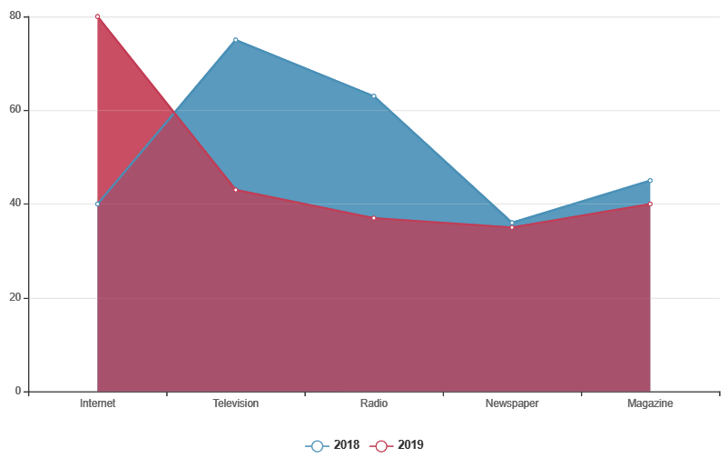
Line and Area Plot
When should you choose a Area plot?
Whenever you have to show multiple variables across time and also check out the data space they take up

Slide 23
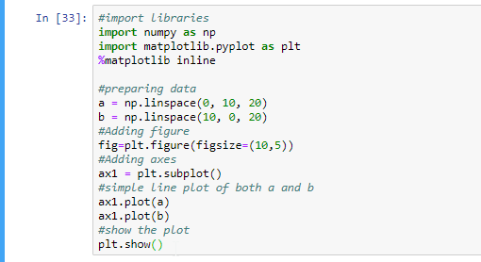
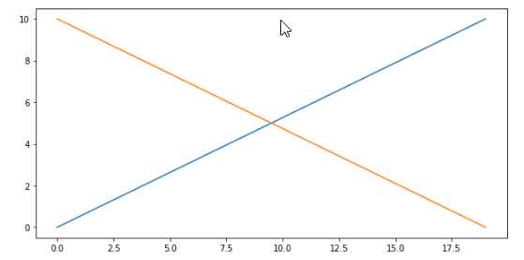
Line and Area Plot
Line plot

Slide 24
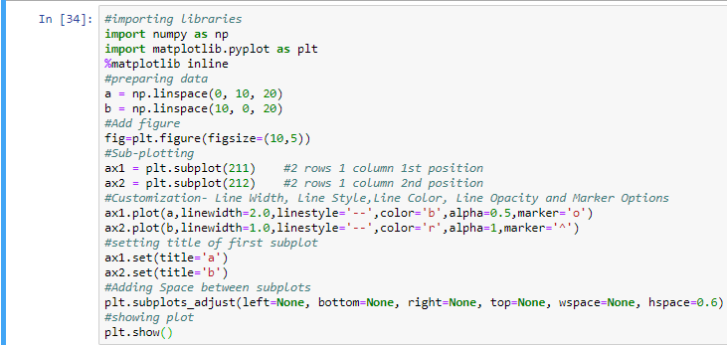
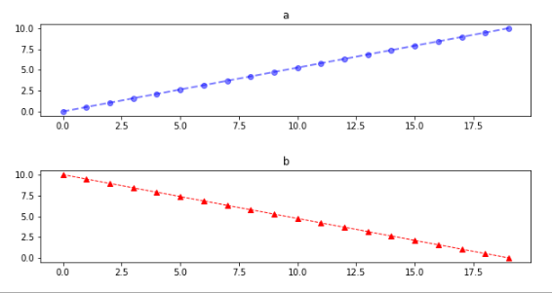
Line and Area Plot
Sub-plotting
Use sub-plotting while comparing 2 or more plots

Slide 25
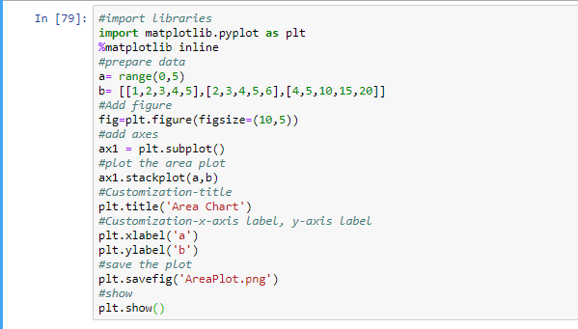
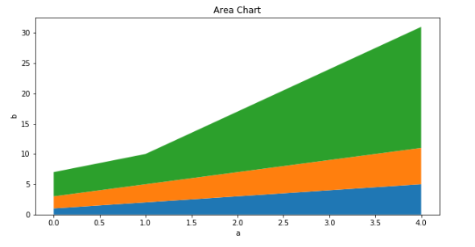
Line and Area Plot
Area plot

Slide 26
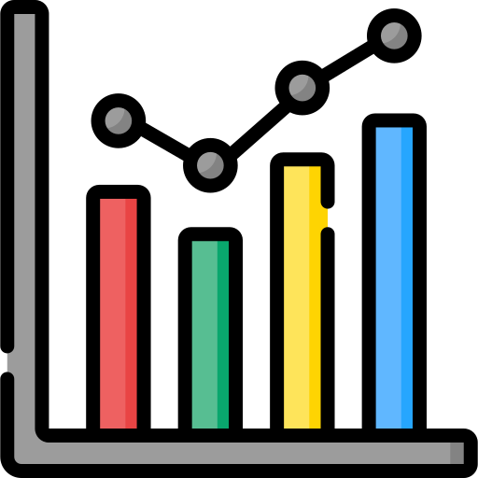
Bar Plot
Bar plot
A bar chart or bar graph is a chart or graph that presents categorical data with rectangular bars with heights or lengths proportional to the values that they represent. The bars can be plotted vertically or horizontally.

Slide 27
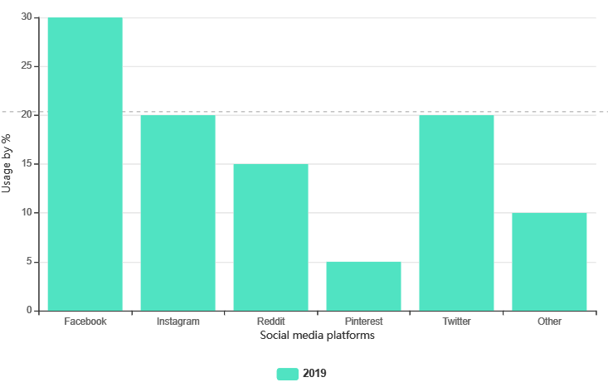
Bar Plot
When should you choose a Bar plot?
Comparing various categories on the same variable. For example, social media usage by percentage over a year.

Slide 28
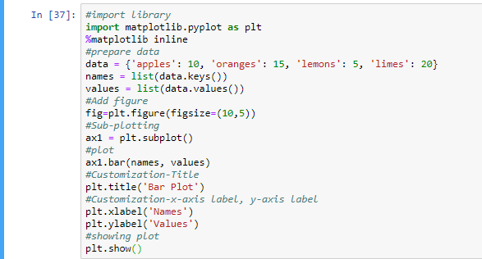
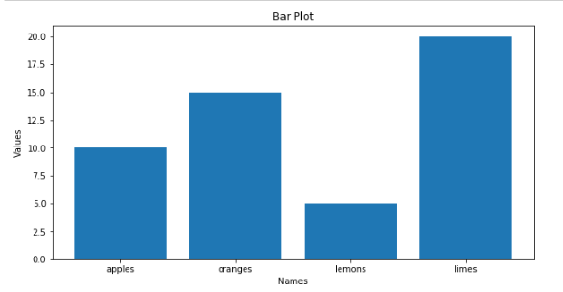
Bar Plot
Bar plot

Slide 29
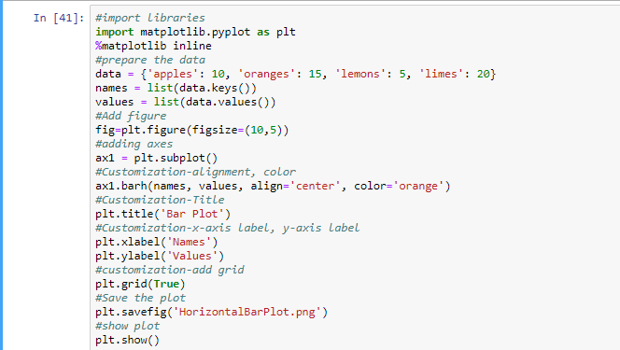
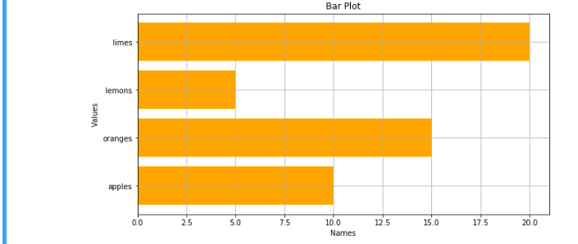
Bar Plot
Horizontal Bar plot

Slide 30

Scatter Plot
Scatter plot
Scatter plots are used to plot data points on a horizontal and a vertical axis in the attempt to show how much one variable is affected by another. Helps visualizing the correlation.

Slide 31
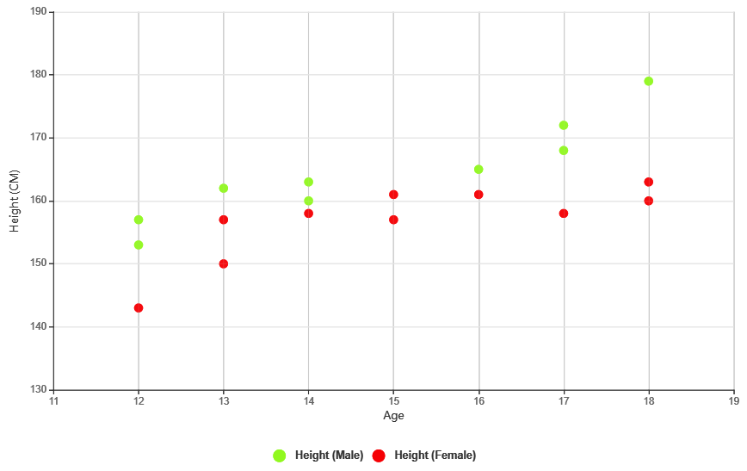
Scatter Plot
When should you choose a Scatter plot?
It is effective when you use while comparing one variable across multiple subjects. For example, Male and Female heights in correspondence with Age.

Slide 32
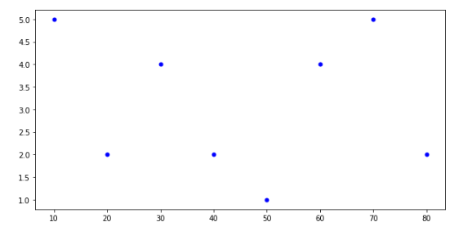
Scatter Plot
Scatter plot

Slide 33
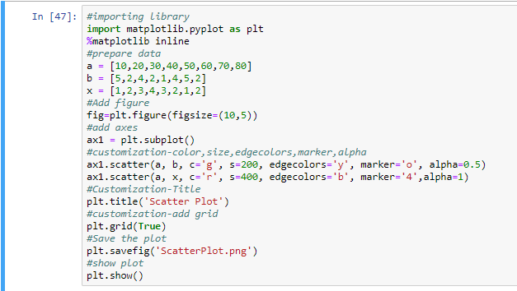
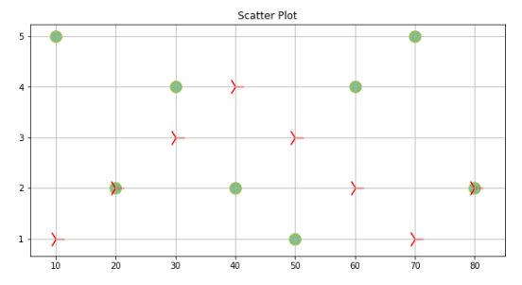
Scatter Plot
Customized Scatter plot

Slide 34

Histogram
Histogram
Plots used to display frequency across a continuous or discrete variable. The final outcome would be a figure of data distribution.

Slide 35
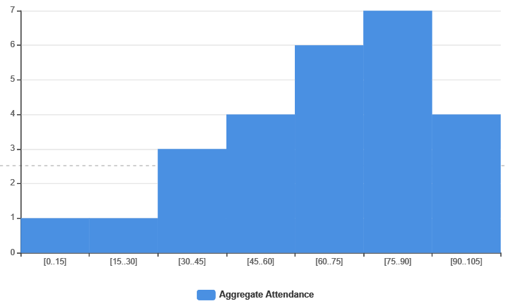
Histogram
When should you choose a Histogram?
When you are trying to show a distribution of data for a variable, you can go ahead with Histogram. For example, aggregate student attendance.

Slide 36
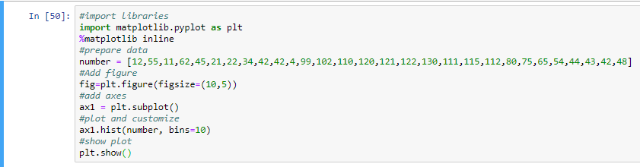
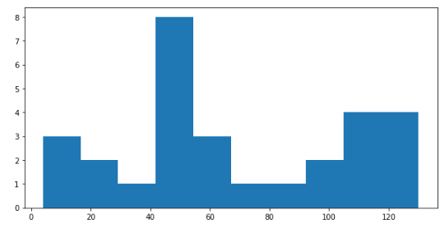
Histogram
Histogram

Slide 37
Box and Violin Plot
Box plot
Box plot is very helpful in viewing the summary of dataset in an efficient way also box plot helps you in doing outlier analysis
Violin plot
Allows to visualize the distribution of a numeric variable for one or several groups. Adapted when the amount of data is huge and showing individual observations gets impossible.

Slide 38
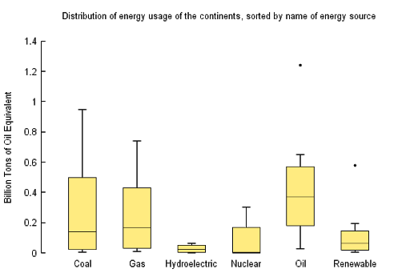
Box and Violin Plot
When should you choose a Box plot?
A box plot is a way of summarizing a set of data measured on an interval scale

Slide 39
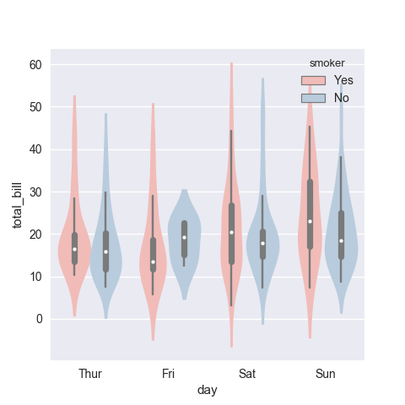
Box and Violin Plot
When should you choose a violin plot?
Same as a Box plot, but more attractive and can show variations better

Slide 40
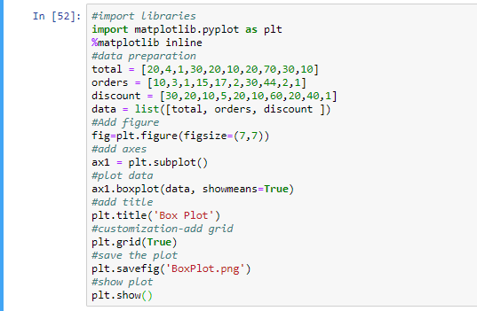
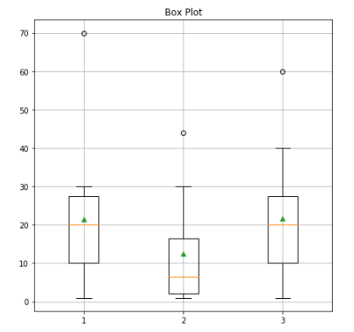
Box and Violin Plot
Box plot

Slide 41
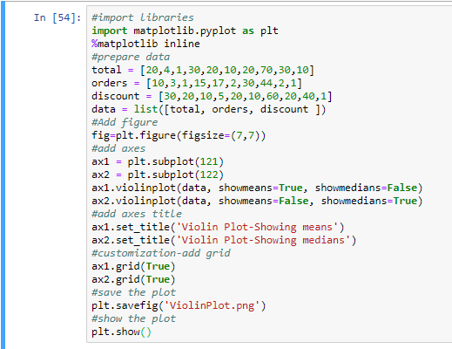
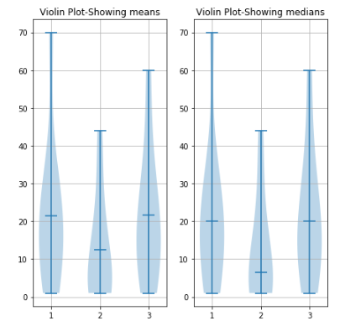
Box and Violin Plot
Violin plot

Slide 42

Image Plot
Image plot
Can be used for image manipulation. You can convert an image into a NumPy array and then use those values to plot the image.

Slide 43
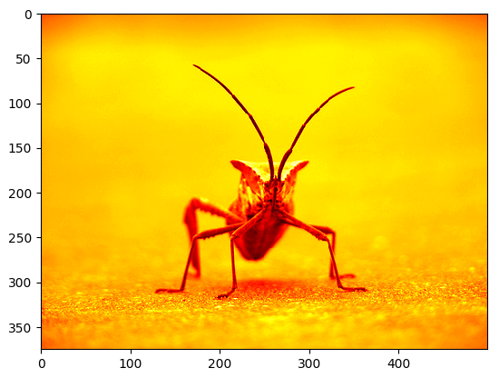
Image Plot
When should you choose a Image plot?
There is no particular use case. You can use this whenever you want to project your image in various color scales or convert it to a NumPy array.

Slide 44
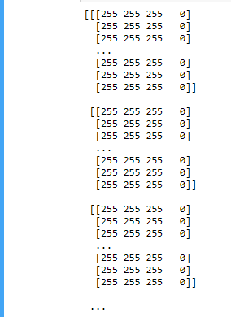

Image Plot
Image plot
Image to NumPy array conversion

Slide 45
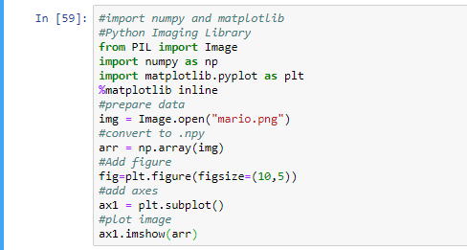
Image Plot
Image plot

Slide 46
Quiver and Stream Plot
Quiver plot
Shows vector lines as arrows, useful in electrical engineering to visualize electrical potential.
Stream plot
A stream plot is a type of 2D plot used to show fluid flow and 2D field gradients

Slide 47
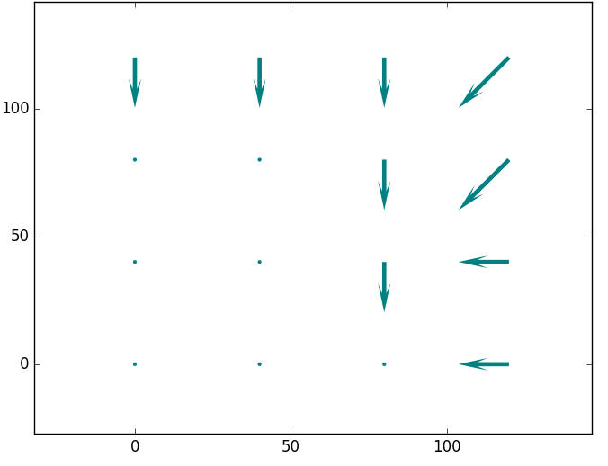
Quiver and Stream Plot
When should you choose a Quiver plot?
Use it when you want to create 2 dimensional field of arrows. For example, making a chart for electrical current fields.

Slide 48

Quiver and Stream Plot
When should you choose a Stream plot?
This is similar to the quiver plot, but you can use this for purposes like ocean current plotting or Area density using the color legend.

Slide 49


Quiver and Stream Plot
Quiver plot

Slide 50


Quiver and Stream Plot
Stream plot

Slide 51

Pie Chart
When should you choose a Pie chart?
Use it when you want to compare sub-parts of whole. For example, different types of fruits.

Slide 52


Pie Chart
Pie Chart

Slide 53


Donut Chart
Donut Chart

Slide 54


Pie Chart and Donut Chart
Pie Chart
Pie Chart is used to show percentage or proportional data, good for displaying data for around 6 categories or fewer
Donut chart can contain more than one data series. Each data series that you plot in a donut chart adds a ring to the chart

Slide 55


Thank You

